Slide 1
MSA Technical Solution Overview
Zhang Long Java Team

Slide 2
Project History

Slide 3
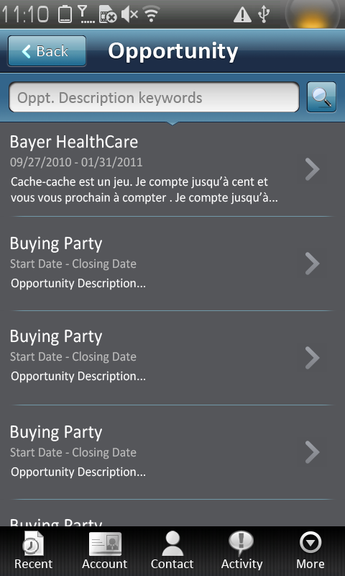
MSA on Lenovo LePhone Sep. 2010 to Dec. 2010
On Lenovo LePhone (Android 1.6 & 2.2)
Online mode & Offline Demo mode
Screen Resolution (800*480,160dpi)
Lean Mode Architecture (ABAP Backend & Android Frontend)
Language: English & Simplified Chinese

Slide 4
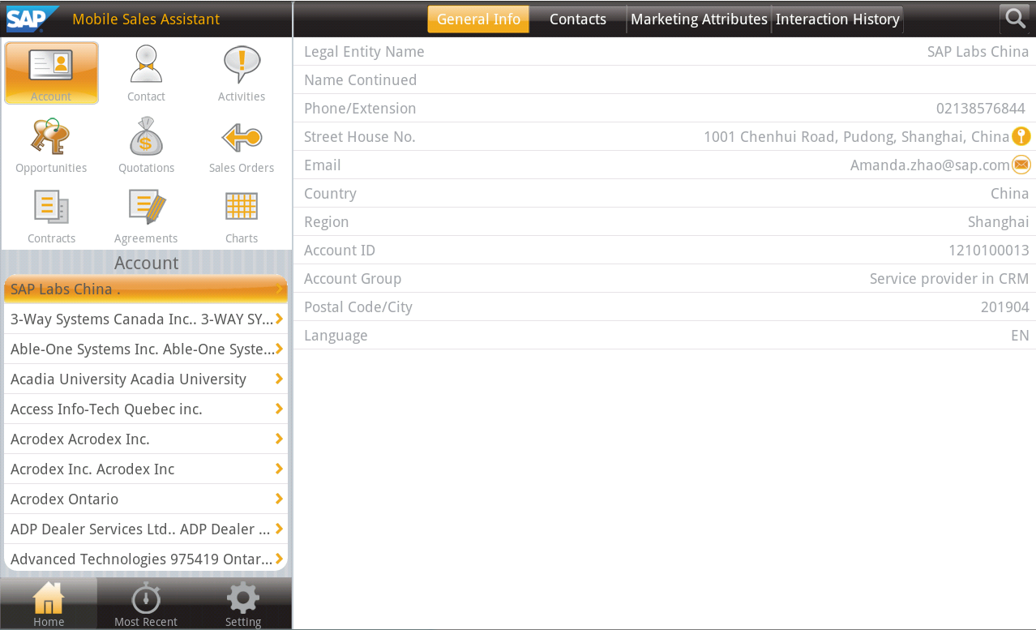
MSA on Lenovo LePad May. 2011
On Lenovo LePad (Android 2.2)
Offline Demo mode only, no backend server
Screen Resolution (1280*800, 160dpi)
Android Frontend Only
Language: English

Slide 5
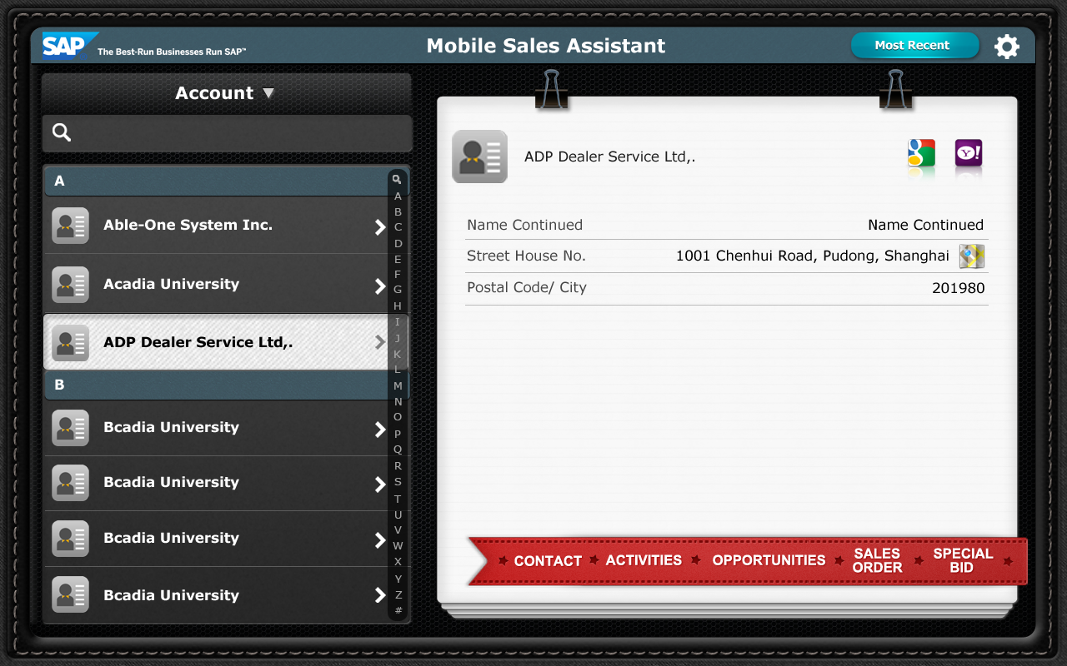
MSA on Lenovo Thinkpad Tablet Apr. 2012 to May. 2012
On Lenovo ThinkPad Tablet (Android 3.1)
Offline Demo Mode & Online Mode
Screen Resolution (1280*800, 160dpi)
Android Frontend & ABAP Backend
Language: English

Slide 6
Technical Solution

Slide 7
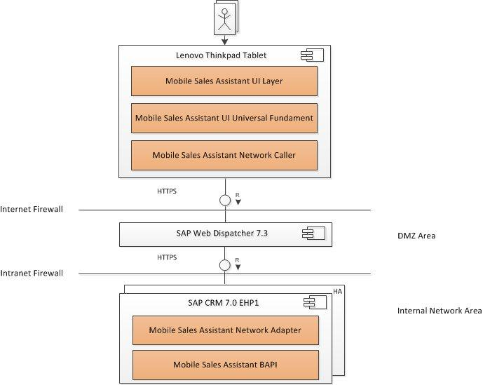
MSA Architecture Lean Mode

Slide 8
Communication
Restful Web Services
No session
No cookie
Access method
Get (Read)
Response
JSON format

Slide 9
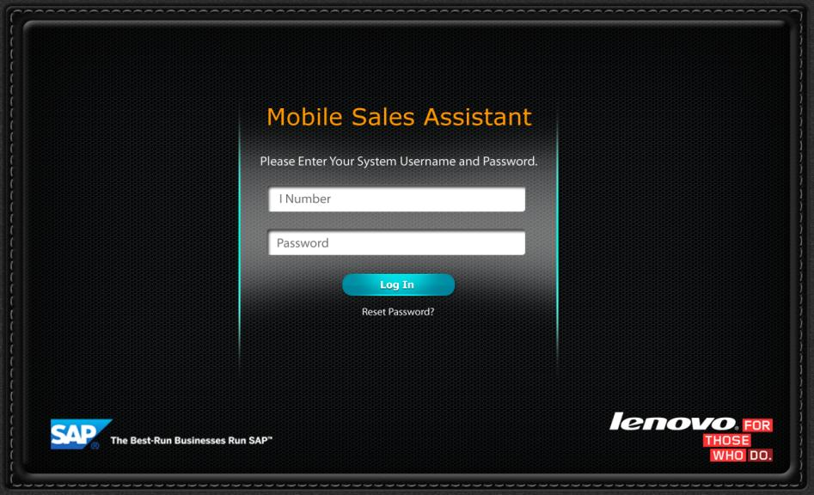
Login Screen

Slide 10
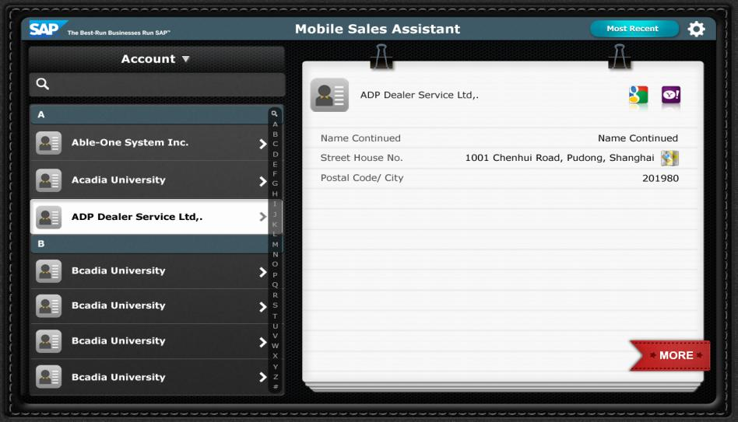
Account Screen

Slide 11
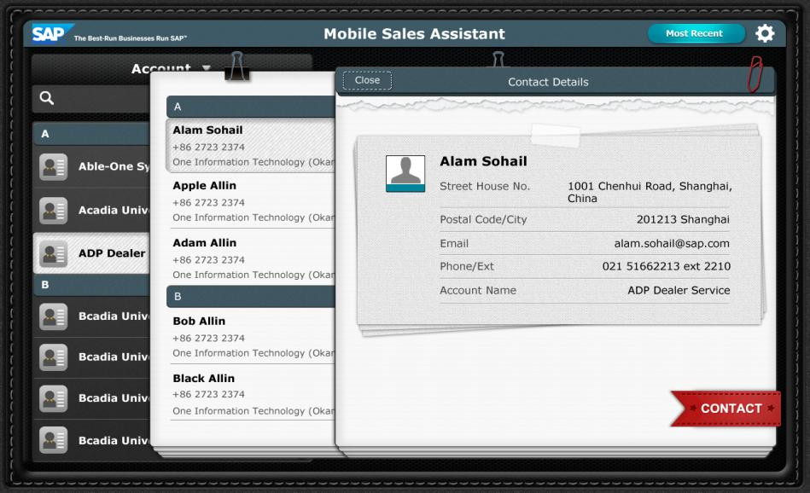
Account Screen

Slide 12
Login Services
Request URL
/logon_crm?user_name=%s&sap-client=%s&sap-language=%s
Response Sample
{
"LOGON_LT_ORG_UNIT": [],
"LOGON_LT_RESP_EMP": [
{
"RESP_EMP": "1213055903"
}
]
}

Slide 13
Account Detail Service
URL:
/account_detail?account_id=%s&sap-client=%s&sap-language=%s
Response Sample:
{
"ID": "1210100013",
"GUID": "4729C414083C00B2E10080000A600E3D",
"ACCOUNT_GROUP": "Service provider in CRM",
"LEGAL_NAME1": "SAP Labs China",
"LEGAL_NAME2": "",
"STREET": "中国上海市浦东新区晨晖路1001号",
"HOUSE_NO": "",
"TELEPHONE": "021610812340",
"EXTENSION": "",
"COUNTRY": "CA",
"COUNTRY_TEXT": "China",
"REGION": "SH",
"REGION_TEXT": "Shanghai",
"POSTL_COD1": "201904",
"CITY": "Shanghai",
"EMAIL": "webmaster@sap.com",
"LANGU": "EN"
}

Slide 14
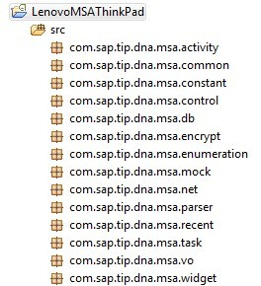
Package Overview

Slide 15
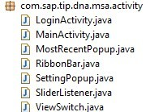
com.sap.tip.dna.msa.activity package
Class Name | Description
LoginActivity | Activity to handle user login interactions, including inputting username/password, create local password, and inputting local password.
MainActivity | Activity to host main panel. This activity has left panel to help user quick navigate to selected item, and right panel to view item content from general to detail. It also has title bar which hosts ‘most recent’ button and setting button.
MostRecentPopup | This class wraps most recent popup view. It let user to view and select list of recent items.
RibbonBar | This class wraps ribbon bar view placed at bottom right corner. This bar helps user quick switch among transactions under one Account item context.
SettingPopup | This class wraps setting popup view. This view let user to define date range and max display number for each transaction.
SliderListener | This class listens user slide left or right gesture on ribbon bar, and do flip animations.
ViewSwitch | This class handles view switches on right panel of main panel.

Slide 16
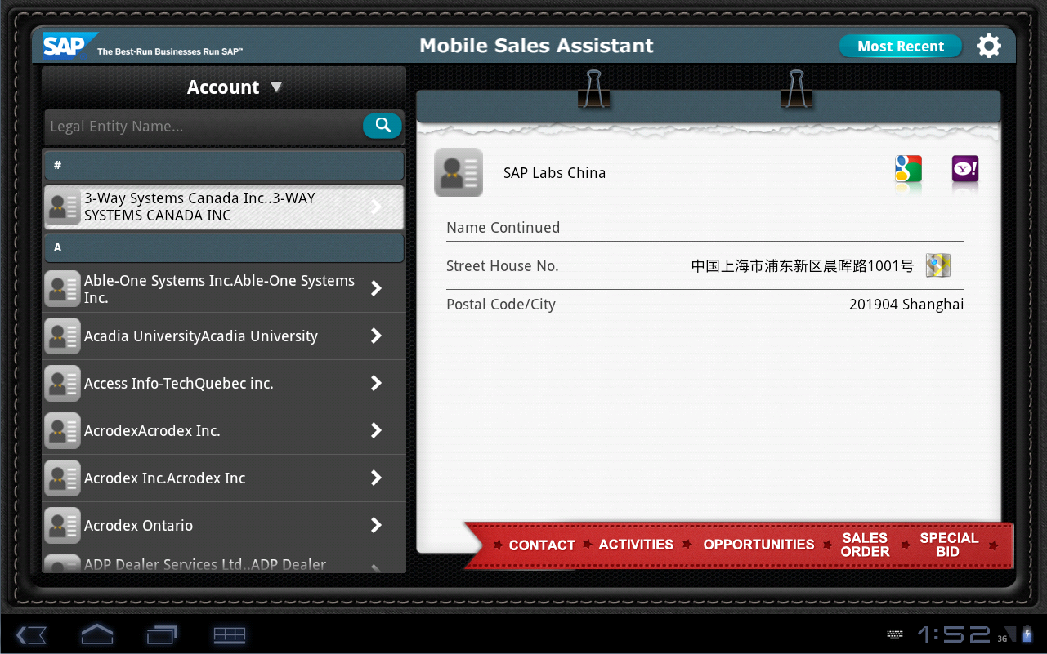
MainActivity

Slide 17
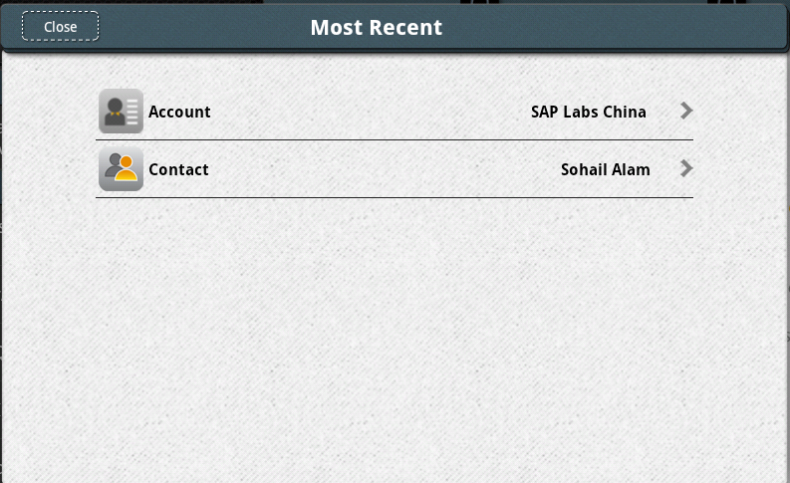
MostRecentPopup

Slide 18
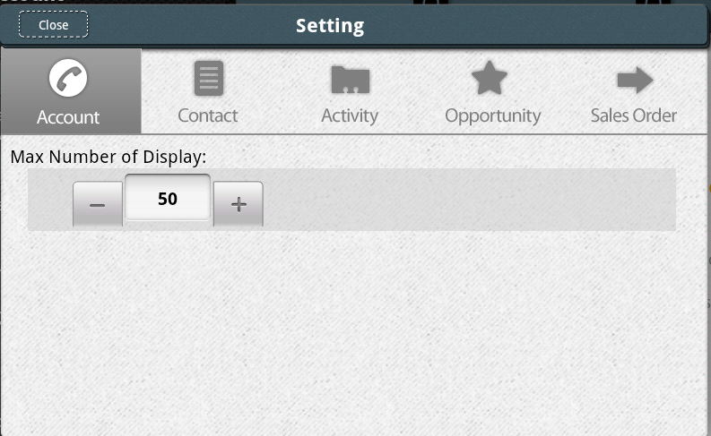
SettingPopup

Slide 19
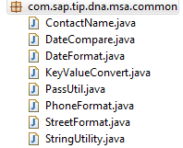
com.sap.tip.dna.msa.common package
Class Name | Description
ContactName | Simple utility class to concatenate contact first name and last name.
DateCompare | Simple utility class to calculate/compare dates.
DateFormat | Simple utility class to convert date/string, date transformation tool.
KeyValueConvert | Special mapping class to handle all key-values mapping for Lenovo customization.
PassUtil | Util class to check user input password.
PhoneFormat | Util class to combine phone and its ext.
StreetFormat | Util class to combine street and number
StringUtility | Util class about string

Slide 20
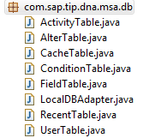
com.sap.tip.dna.msa.db package
Class Name | Description
ActivityTable | Represents table to persist activity object. It provides methods to create table, clear table and query table.
AlterTable | Represents table to persist alter object. It provides methods to create table, clear table and query table.
CacheTable | Represents table to persist json string cache object. It provides methods to create table, clear table and query table.
ConditionTable | Represents table to persist system condition object. It provides methods to create table, clear table and query table.
FieldTable | Represents table to persist SysField object. It provides methods to create table, clear table and query table.
LocalDBAdapter | Represents adpater to quick access other table objects. It also supports db operations.
RecentTable | Represents table to persist recent object. It provides methods to create table, clear table and query table.
UserTable | Represents table to persist user object. It provides methods to create table, clear table and query table.

Slide 21

com.sap.tip.dna.msa.encrypt package
Class Name | Description
Base64Coder | Utility class to encode and decode byte array in base64 format.
DesEncrypt | DES utility class to encrypt and decrypt string.
PassEncrypt | Password utility class to encrypt and decrypt password string.
SHA1Hash | SHA1 utility class to calculate SHA1 value of a string.

Slide 22
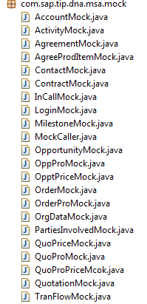
com.sap.tip.dna.msa.mock package
Class Name | Description
AccountMock | Mock class to host json string, which is for offline demo
ActivityMock | Mock class to host json string, which is for offline demo
AgreementMock | Mock class to host json string, which is for offline demo
AgreeProdItemMock | Mock class to host json string, which is for offline demo
ContactMock | Mock class to host json string, which is for offline demo
ContractMock | Mock class to host json string, which is for offline demo
InCallMock | Mock class to host json string, which is for offline demo
LoginMock | Mock class to host json string, which is for offline demo
MilestoneMock | Mock class to host json string, which is for offline demo
MockCaller | Mock class to host json string, which is for offline demo
OpportunityMock | Mock class to host json string, which is for offline demo
OppProMock | Mock class to host json string, which is for offline demo
OpptPriceMock | Mock class to host json string, which is for offline demo

Slide 23
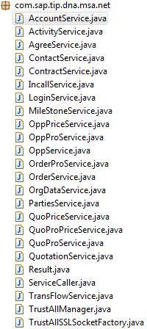
com.sap.tip.dna.msa.net package
Class Name | Description
AccountService | Represents http service for account
ActivityService | Represents http service for activity
AgreeService | Represents http service for agreement
ContactService | Represents http service for contact
ContractService | Represents http service for contract
IncallService | Represents http service for incoming call
LoginService | Represents http service for login
MileStoneService | Represents http service for milestone
OppPriceService | Represents http service for opportunity price
OppProService | Represents http service for opportunity product
OppService | Represents http service for opportunity
OrderProService | Represents http service for order product

Slide 24
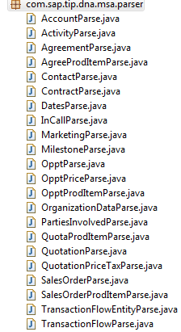
com.sap.tip.dna.msa.parser package
Class Name | Description
AccountParse | Represents json string & object parser for account
ActivityParse | Represents json string & object parser for activity
AgreementParse | Represents json string & object parser for agreement
AgreeProdItemParse | Represents json string & object parser for agree product item
ContactParse | Represents json string & object parser for contact
ContractParse | Represents json string & object parser for contract
DatesParse | Represents json string & object parser for dates
InCallParse | Represents json string & object parser for incall
MarketingParse | Represents json string & object parser for marketing
MilestoneParse | Represents json string & object parser for milestone
OpptParse | Represents json string & object parser for opportunity
OpptPriceParse | Represents json string & object parser for opportunity price

Slide 25
com.sap.tip.dna.msa.parser package
Class Name | Description
OpptProdItemParse | Represents json string & object parser for opportunity product item
OrganizationDataParse | Represents json string & object parser for organization data
PartiesInvolvedParse | Represents json string & object parser for parties involved
QuotaProdItemParse | Represents json string & object parser for quotation product item
QuotationParse | Represents json string & object parser for quotation
QuotationPriceTaxParse | Represents json string & object parser for quotation price tax
SalesOrderParse | Represents json string & object parser for sales order
SalesOrderProdItemParse | Represents json string & object parser for sales order product item
TransactionFlowEntityParse | Represents json string & object parser for transaction flow entity
TransactionFlowParse | Represents json string & object parser for transaction

Slide 26
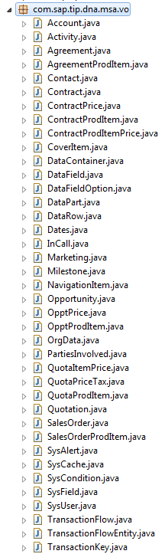
com.sap.tip.dna.msa.vo package
Class Name | Description
Opportunity | Opportunity Object
OpptPrice | Opportunity Price
OpptProdItem | Opportunity Product Item
OrgData | Organization Data
PartiesInvolved | Parties Involved
QuotaItemPrice | Quotation Item Price
QuotaPriceTax | Quotation Price & Tax
QuotaProdItem | Quotation Product Item
Quotation | Quotation Object
SalesOrder | Sales Order Object
SalesOrderProdItem | Sales Order Product Item
SysAlert | Alert for Activity

